Slide 1
NEURAL NETWORKS PROJECT
Aimen Umar SP23-BAI-008
Malaika Nadeem SP23-BAI-024

Slide 2
DATASET DESCRIPTION
1. California Housing Dataset (ANN Regression)
Size: 20640
Features: 8
Target: Median house value (real)
2. MNIST Dataset (ANN Classification)
Size: 60,000 train, 10,000 test
Features: 28x28 grayscale images
Classes: 10
3. CIFAR-10 Dataset (CNN Classification)
Size: 50,000 train, 10,000 test
Features: 32x32 color images (3 channels)
Classes: 10 (e.g., airplane, car, bird, etc.)

Slide 3
DATASET DESCRIPTION
1. Combined Cycle Power Plant Housing Dataset (ANN Regression)
Size: 9568
Features: 4
Target: PE (Continous)
2. Fashion-MNIST Dataset (ANN Classification)
Size: 60,000 train, 10,000 test
Features: 28x28 grayscale images
Classes: 10 (e.g., t-shirt, trouser, pullover, etc.)
3. Fashion-MNIST Dataset (CNN Classification)
Size: 60,000 train, 10,000 test
Features: 28x28 color images (1 channel)
Classes: 10 (e.g., t-shirt, trouser, pullover, etc.)

Slide 4
Model | Dataset | Key Hyperparameters | Final Metrics | Training Time
ANN Regression | Combined cycle power plant | Epochs: 100 Number of hidden layers: 3 Neurons: {4, 128, 64, 16} Learning rate: 0.01 Batch size: 64 | Mse: 0.0595 Mae: 0.1853 | 57.8s
ANN Regression | Combined cycle power plant | Epochs: 100 Number of hidden layers: 3 Neurons: {4, 64, 32, 16} Learning rate: 0.001 Batch size: 64 | Mse: 1.1879 Mae: 0.8302 | 61.8s
ANN Regression | Combined cycle power plant | Epochs: 100 Number of hidden layers: 3 Neurons: {4, 64, 32, 16} Learning rate: 0.001 Batch size: 32 | Mse: 3.0697 Mae: 1.3972 | 77.65s
ANN Classification | Fashion-Mnist | Epochs: 75 Number of hidden layers: 4 Neurons: {784, 512, 384, 256, 128, 10} Learning rate: 0.001 Batch size: 64 | Accuracy: 86.53 Precision: 86.64 Recall: 86.66 F1: 86.64 | 2327.44s
ANN Classification | Fashion-Mnist | Epochs: 50 Number of hidden layers: 4 Neurons: {784, 512, 384, 256, 128, 10} Learning rate: 0.001 Batch size: 32 | Accuracy: 81.45 Precision: 83.32 Recall: 81.47 F1: 81.53 | 1789.2s
ANN Classification | Fashion-Mnist | Epochs: 50 Number of hidden layers: 3 Neurons: {784, 512, 384, 256, 128, 10} Learning rate: 0.001 Batch size: 64 | Accuracy: 85.32 Precision: 85.33 Recall: 85.31 F1: 84.41 | 1545.42

Slide 5
Model | Dataset | Key Hyperparameters | Final Metrics | Training Time
CNN Classification | Fashion-Mnist | Epochs: 10 Number of dense layers: 2 Number of Conv2d: 3 Number of Max pooling: 3 Neurons: {512, 256,10} Learning rate: 0.001 Batch size: 64 | Train accuracy: 99.05 Validation accuracy: 92.62 Test accuracy: 92.27 Precision: 92.28 Recall: 92.27 F1: 92.27 | 89.27s
CNN Classification | Fashion-Mnist | Epochs: 50 Number of dense layers: 2 Number of Conv2d: 3 Number of Max pooling: 2 Neurons: {128,10} Learning rate: 0.01 Batch size: 64 | Train accuracy: 86.33 Validation accuracy: 87.37 Test accuracy: 86.58 Precision: 86.80 Recall: 86.57 F1: 86.62 | 248.63s
CNN Classification | Fashion-Mnist | Epochs: 100 Number of dense layers: 3 Number of Conv2d: 3 Number of Max pooling: 3 Neurons: {256,128,10} Learning rate: 0.001 Batch size: 128 | Train accuracy: 99.75 Validation accuracy: 92.10 Test accuracy: 91.9 | 378.12s
ANN Regression | California Housing Dataset | Epochs: 100 Number of hidden layers: 3 Neurons: {8,64,16,8,1} Learning rate: 0.0001 Batch size: 64 | Mse: 0.7220 Mae: 0.6322 | 1min17sec
ANN Regression | California Housing Dataset | Epochs: 100 Number of hidden layers: 3 Neurons: {8,8,4,2,1} Learning rate: 0.0001 Batch size: 64 | Mse: 0.8819 Mae: 0.7173 | 1min 7sec
ANN Regression | California Housing Dataset | Epochs: 100 Number of hidden layers: 3 Neurons: {8,16,8,4,1} Learning rate: 0.0001 Batch size: 64 | Mse: 0.9727 Mae: 0.7753 | 38sec

Slide 6
Model | Dataset | Key Hyperparameters | Final Metrics | Training Time
ANN Classification | MNIST | Epochs: 100 Number of hidden layers: 3 Neurons: {784, 512, 256, 128, 10} Learning rate: 0.001 Batch size: 64 | Accuracy: 97.57 Precision: 97.559 Recall: 97.550 F1: 97.552 | 24 min
ANN Classification | MNIST | Epochs: 100 Number of hidden layers: 4 Neurons: {784, 512, 384, 256, 128, 10} Learning rate: 0.001 Batch size: 64 | Accuracy: 97.47 Precision: 97.440 Recall: 97.463 F1: 97.446 | 24 min 31 sec
ANN Classification | MNIST | Epochs: 100 Number of hidden layers: 3 Neurons: {784, 256, 128, 64, 10} Learning rate: 0.001 Batch size: 64 | Accuracy: 96.87 Precision: 96.85 Recall: 96.86 F1: 96.85 | 20min
CNN Classification | Cifar10 | Epochs: 100 Number of dense layers: 2 Number of Conv2d: 6 Number of Max pooling: 3 Neurons: {256,10} Learning rate: 0.001 Batch size: 64 | Train accuracy: 95.55 Validation accuracy: 87.69 Test accuracy: 87.690 Precision: 87.75 Recall: 87.69 F1: 87.67 | 14min 57sec
CNN Classification | Cifar10 | Epochs: 100 Number of dense layers: 2 Number of Conv2d: 6 Number of Max pooling: 3 Neurons: {128,10} Learning rate: 0.001 Batch size: 64 | Train accuracy: 96.59 Validation accuracy: 85.31 Test accuracy: 85.310 Precision: 85.88 Recall: 85.31 F1: 85.20 | 14min 30sec
CNN Classification | Cifar10 | Epochs: 100 Number of dense layers: 2 Number of Conv2d: 6 Number of Max pooling: 3 Neurons: {256,10} Learning rate: 0.0001 Batch size: 64 | Train accuracy: 88.61 Validation accuracy: 84.80 Test accuracy: 84.79 Precision: 84.97 Recall: 84.80 F1: 84.67 | 14min

Slide 7
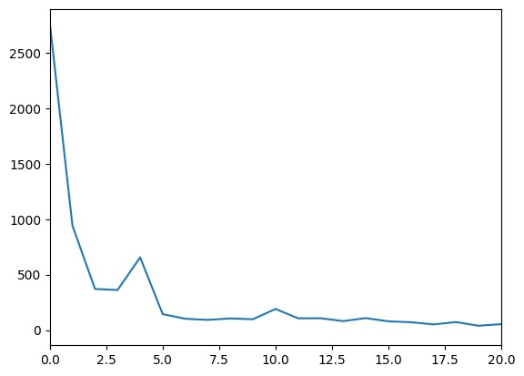

Image SLide
ANN Regression California Housing Dataset Losses

Slide 8
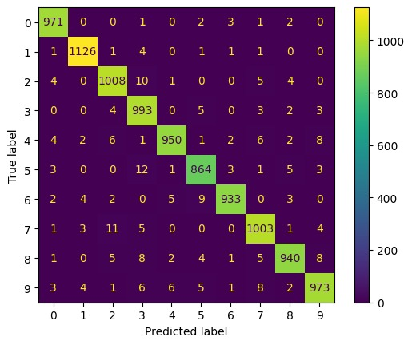
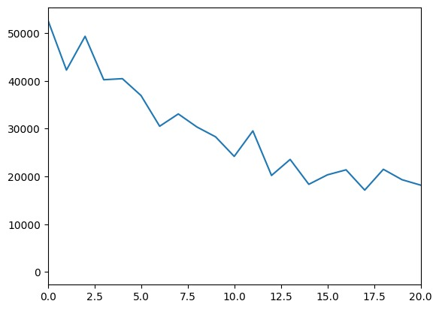
Image SLide
ANN Classification MNIST

Slide 9
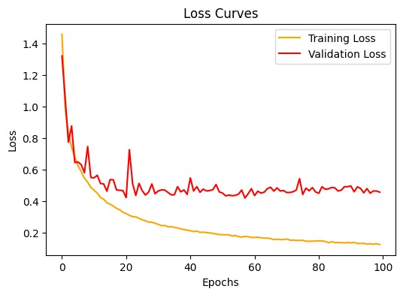
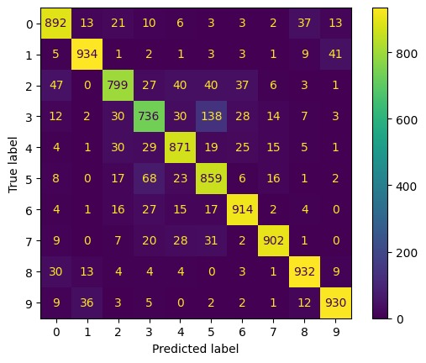
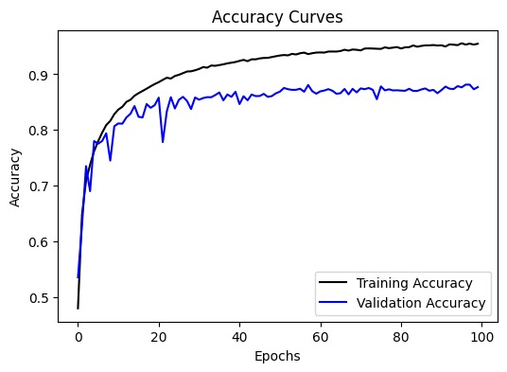
Image SLide
CNN Classification Cifar10

Slide 10
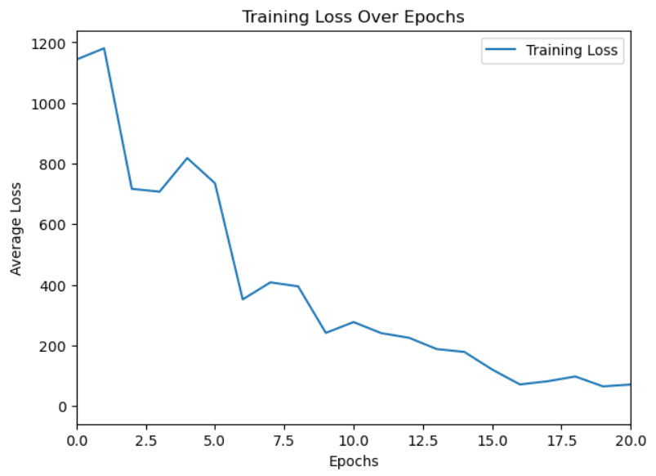
Image SLide
ANN Regression Combined Cycle Power Plant Dataset Losses

Slide 11
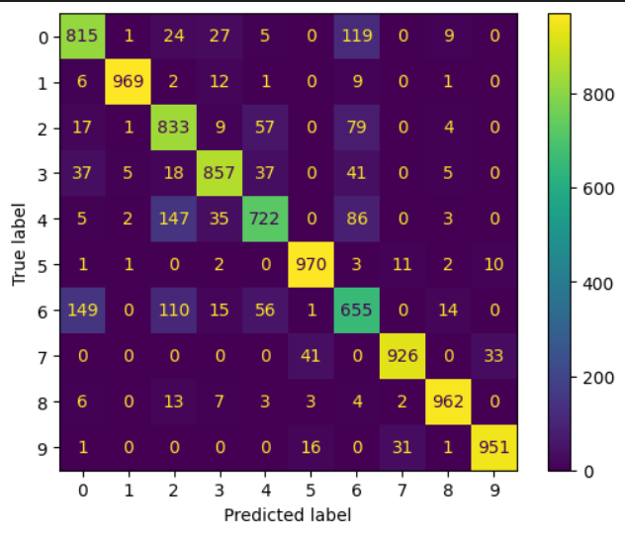
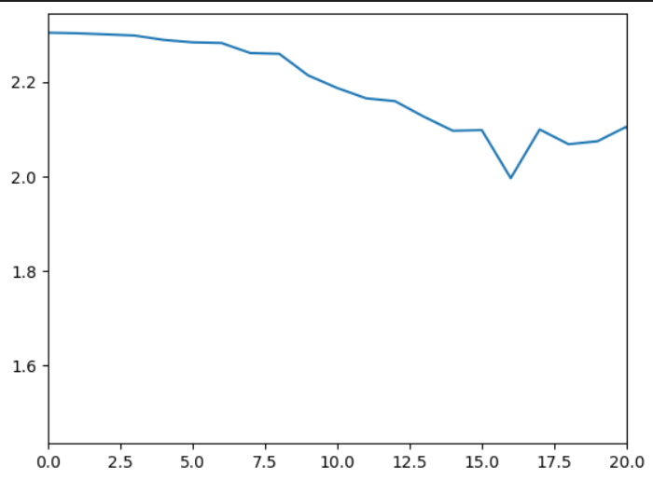
Image SLide
ANN Classification Fashion-MNIST

Slide 12
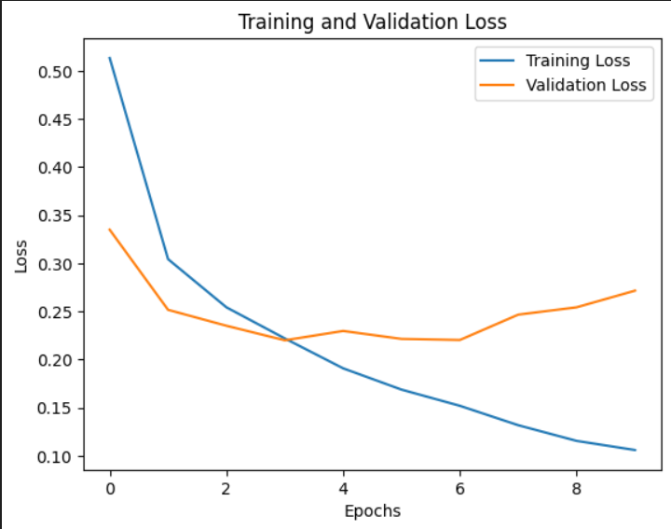
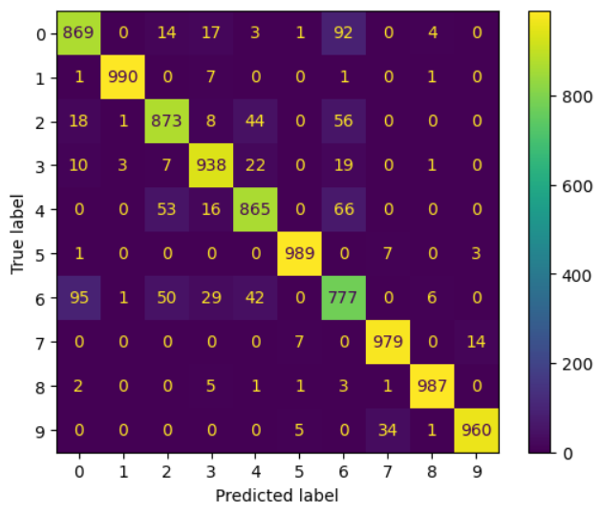
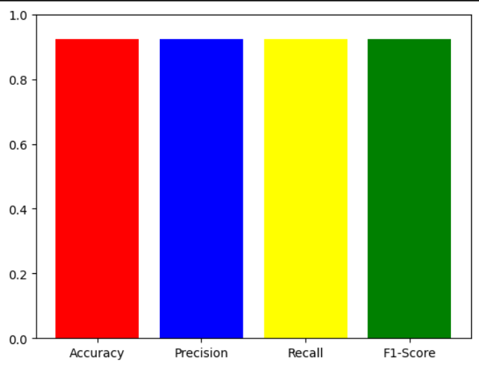
Image SLide
CNN Classification Fashion-MNIST

